Slide 1
Bladed Weapons // Armas Blancas
Mary Iacobelli

Slide 2
Bladed Weapon: Arma Blanca
Bladed weapons (armas blancas) include a number of objects such as knives (cuchillos) and other similar weapons which typically have a flat shape (forma aplanada) and a cutting edge (filo) and a point or tip (punta). Blades can also be serrated(dentellado).
Other examples of a bladed weapon include a: sword (espada), dagger (daga o puñal), saber (sable), rapier (estoque), stiletto (estilete), machete (machete), spear (lanza), icepick (punzón para el hielo)

Slide 3
Knives (cuchillos)
Knives have a grip (puño), also referred to as the handle of the knife and a pommel (pomo) which is immediately behind the grip. The hilt (empuñadura) includes both the grip and pommel of a knife.
The cutting edge (filo) or the point or tip (punta) of a knife are what typically cut and cause harm and injury. Some knives have a double cutting edge (doble filo). The choil (escotadura) is the end of a knife edge opposite the tip.
The blade (hoja) which includes the cutting edge (filo) is the sharpened side of a knife which does the cutting. The fuller (canal) is a groove on the side of a knife blade. Knives can have a blade that is fixed (de hoja fija) relative to the hilt or the blade can fold (de hoja plegable) into the handle of the knife. The tang (espiga) is the part of a knife blade that extends back into and attaches to the hilt.
The cross guard (cruz o gavilán) or guard (guarda) is typically the part of many knives that separates the grip from the blade and prevent’s the user’s hand from sliding forward onto the blade. The ricasso (recazo) is the flat, squared-off part of a knife blade next to the cross guard.
A sheath or scabbard (vaina) is a covering for a knife’s blade (hoja).

Slide 4
Point or tip (punta) Edge (filo) Blade (hoja) Heel (talón de la hoja) Bolster (cabeza) Tang (espiga) Handle (mango o empuñadura) Butt (pomo) Spine (lomo)

Slide 5
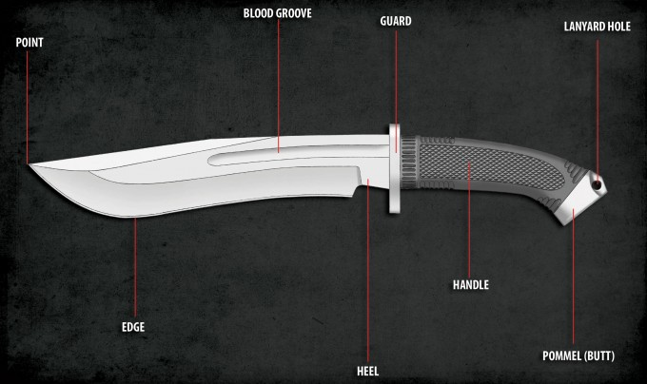
MORE PARTS OF A KNIFE: Point (punta) Blood Groove (canal) Guard (guarda) Lanyard hole (apertura para cordel) Pommel (pomo) )

Slide 6
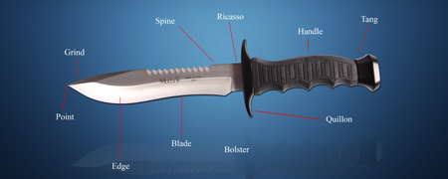
DOUBLE EDGED KNIFE// Cuchillo de doble filo: Grind (bisel) Spine (lomo) Ricasso (recazo) Tang (espiga) Quillon (cruz o gavilán)

Slide 7
Knives sometimes used as weapons
Jack-knife (navaja): a folding-blade pocket knife.
Penknife (cortaplumas): a very small folding pocket knife.
Pocket knife (navaja): small enough to fit in one’s pocket.
Swiss army knife (navaja de mil usos): a pocket knife with multiple blades and tools.
Switchblade (navaja de resorte): a folding knife whose blade is spring-loaded and can be opened quickly by releasing a catch.
Hunting knife (cuchillo de monte): a large knife that does not have a folding blade

Slide 8
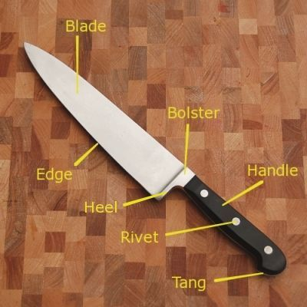
PARTS OF A KITCHEN KNIFE: Blade (hoja) Edge (filo) Heel (talón de la hoja) Bolster (cabeza) handle (mango o puño) Tang (espiga) Rivet (remache)

Slide 9
Kitchen knives (cuchillos de cocina) and other utensils
Butcher knife (cuchillo de carnicero)
Boning knife (cuchillo para deshuesar)
Bread knife (cuchillo de pan)
Carving knife (cuchillo de trinchar, trinchador)
Chef’s knife (cuchillo de carnicero)
Cleaver (hacha de cocinero)
Filleting knife (cuchillo filetero)
Paring knife (cuchillo de pelar)
Steak knife (cuchillo de carne
Peeler (pelapapas)
Kitchen scissors (Tijeras de cocina)

Slide 10
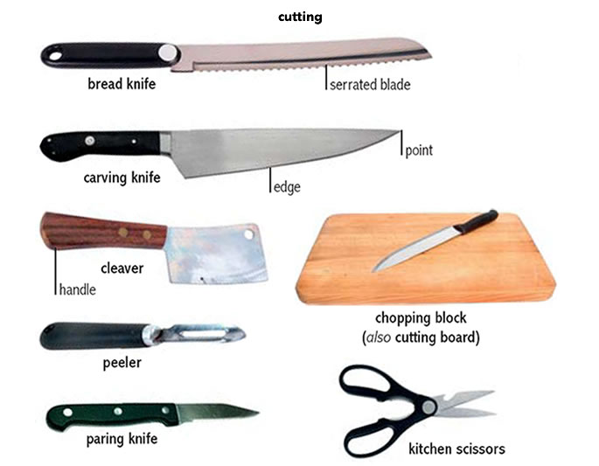
Kitchen knives and other utensils

Slide 11
PARTS OF A SWORD (ESPADA). Pommel (pomo), Grip (puño), Hilt (mango), Cross-guard (gavilán), Fuller (canal), Edge (filo), Blade (hoja), Point (punta)

Slide 12
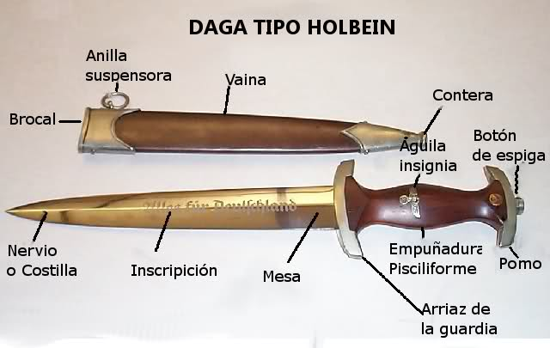
PARTS OF A DAGGER (DAGA): Brocal (rim), Vaina (scabbard), Anilla Suspensora (ring), Contera (ferrule), Botón de espiga (pommel nut), Nervio (blade), Mesa (side or flat), Arriaz de la guardia (cross guard), Empuñadura (handle), Aguila insignia (Eagle insignia)

Slide 13
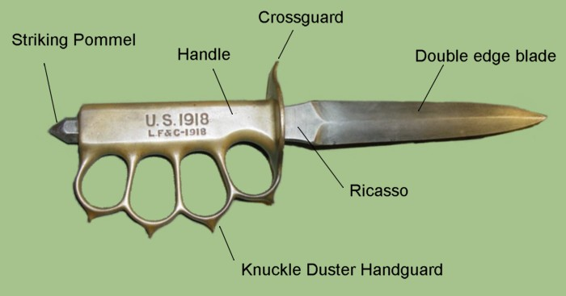
Bladed weapon with double edge blade and knuckle duster hand guard: Arma blanca con hoja de doble filo, manopla y pomo para atacar

Slide 14
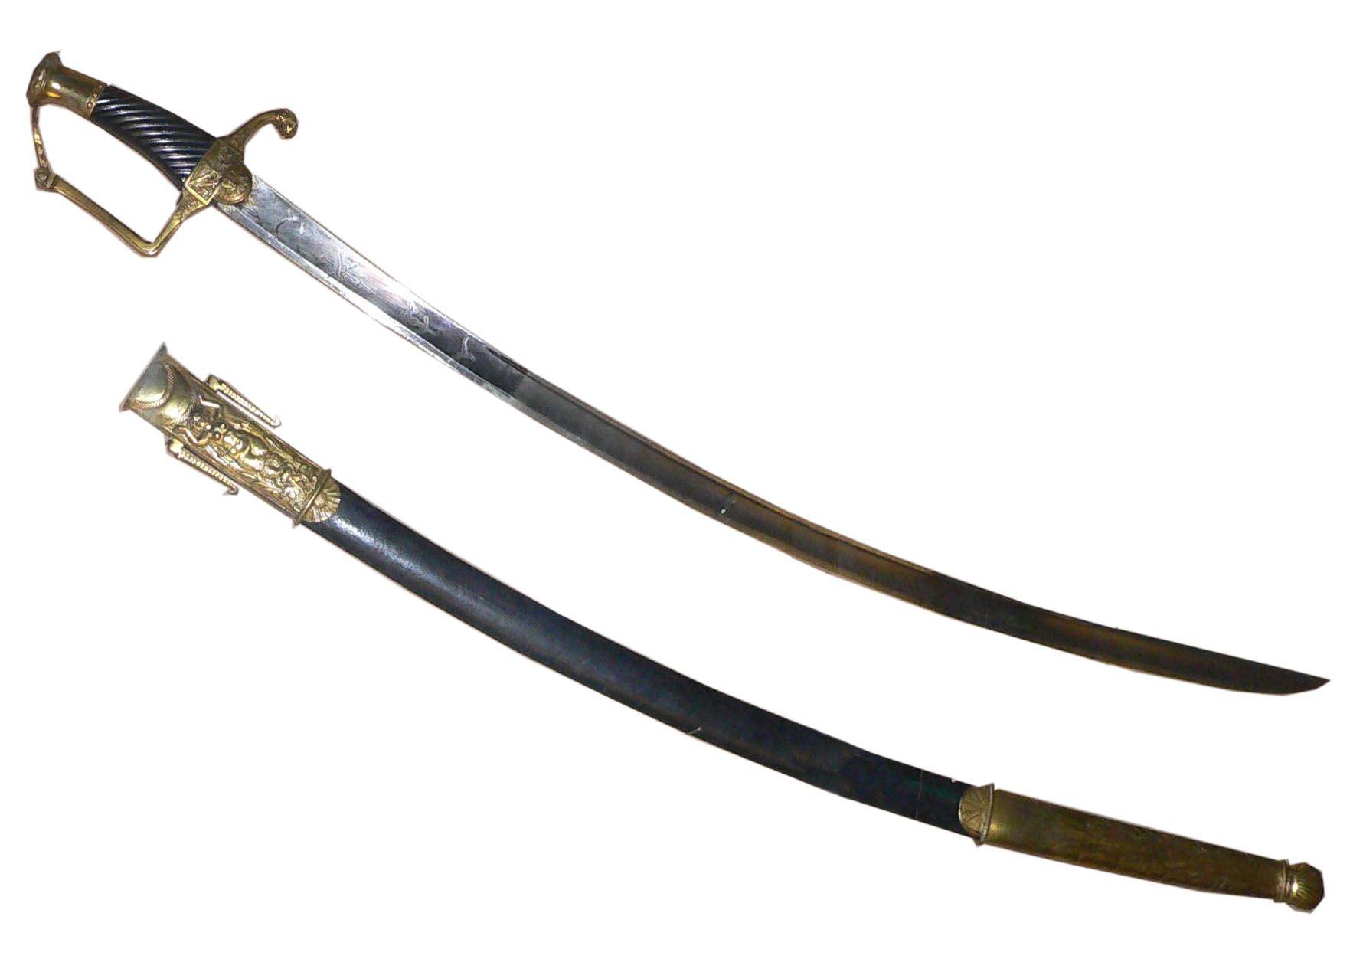
Saber (sable)

Slide 15
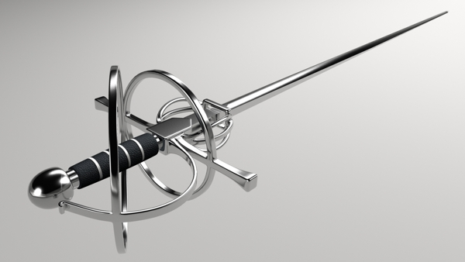
Rapier (estoque)

Slide 16
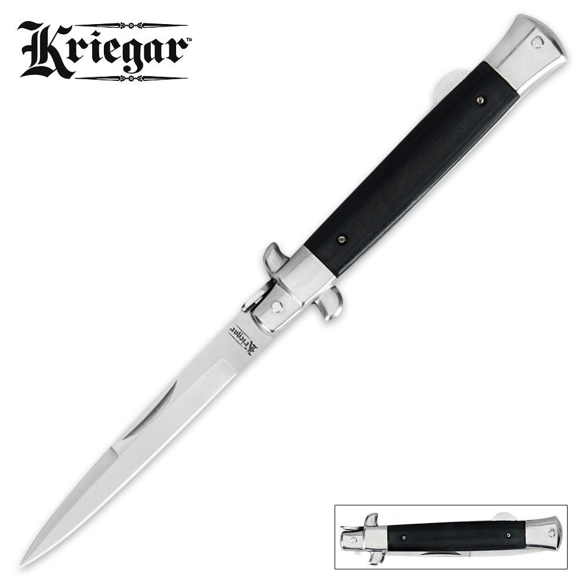
Stiletto pocketknife (navaja tipo estilete)

Slide 17
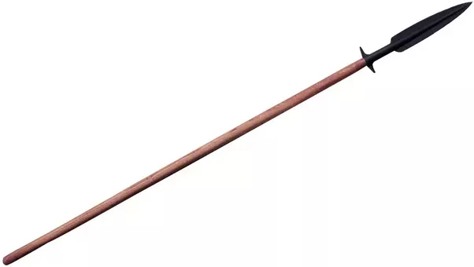
Spear (lanza)

Slide 18
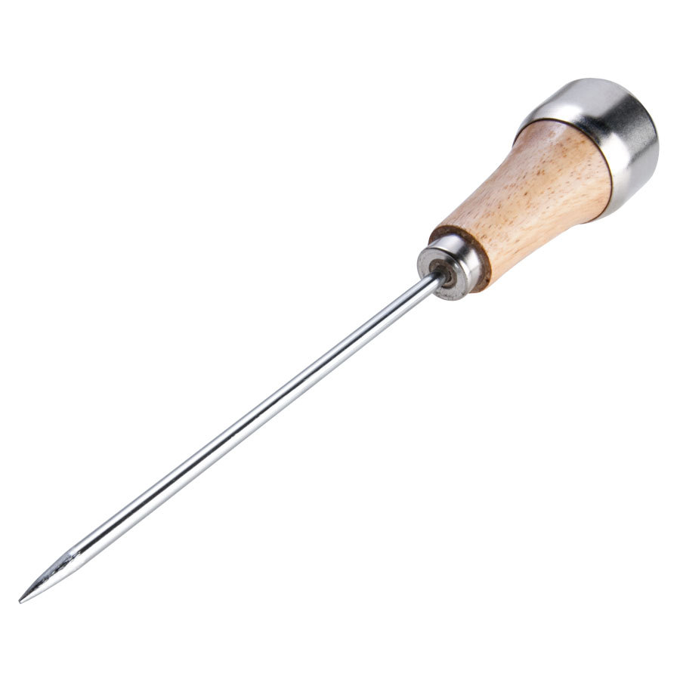
Icepick (punzón para el hielo)

Slide 19
Wounds caused by sharp instruments : Heridas causadas por objetos punzo cortantes. Herida de incisa, herida de apuñalada, herida de empalamiento, herida de defensa

Slide 20
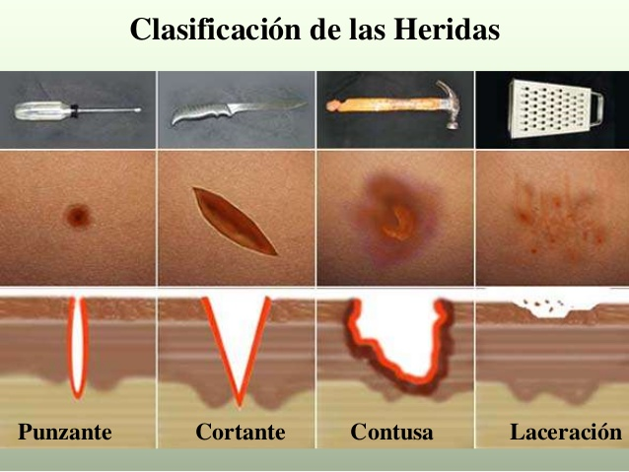
Types of wounds from sharp instruments: Punzante (stab wound), Cortante(cut), Contusa (bruise), Laceración (laceration)

Slide 21
Sources
Merriam Webster’s Spanish-English Visual Dictionary 2011
El pequeño Larousse ilustrado 2008. Diccionario Enciclopédico.
The Interpreter’s Companion by Holly Mikkelson, Fourth Edition: 2000
www.googleimages.com

