Slide 1
Copyright Notice
The following content, including but not limited to, lesson plans, course materials, educational exercises, video recordings containing the voice, teaching methods and likeness of our instruction team, and all other media provided as a part of this online course remain the exclusive intellectual property of DE LA MORA Interpreter Training. This copyrighted material is expressly for the use of students of the course for which it is displayed, and may not be be recorded, shared, or otherwise distributed. The unauthorized reproduction or distribution of a copyrighted work is illegal. Criminal copyright infringement, including infringement without monetary gain, is prohibited by law.

Slide 2
INTRODUCTION TO COURT INTERPRETATION
PART 1
DELAMORA Signature Training Program™

Slide 3
Weightlifting for Court Interpreters™
Work that brain muscle!

Slide 4
Agustin’s Golden Rule
Did you hear what you just said?

Slide 5
The Constitution of the United States of America
5th, 6th and 14th ammendments
THE RIGHT TO AN INTERPRETER

Slide 6
Amendments to the Constitution of the United States
5th: December 15, 1791. Protects the right to due process, prohibits self-incrimination
6th: December 15, 1791. Protects the right to a fair and speedy public trial by jury, to confront the accuser, to obtain witnesses and to retain counsel.
14th. July 9, 1868. No State can deprive any person of life, liberty, or property, without due process of law; nor deny to any person within its jurisdiction the equal protection of the laws.

Slide 7
The story of Rogelio Nieves Negron
434F.2nd 386 (2nd Cir.1970)
THE RIGHT TO AN INTERPRETER

Slide 8
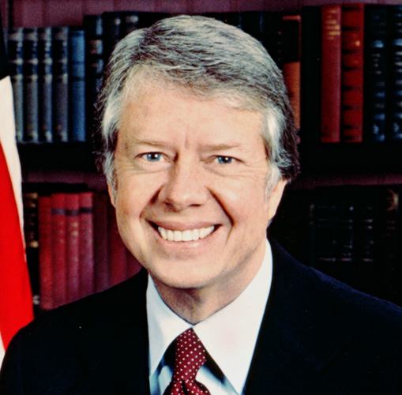
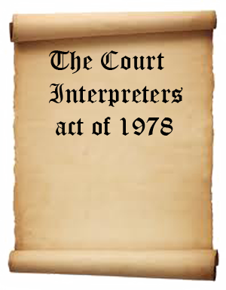
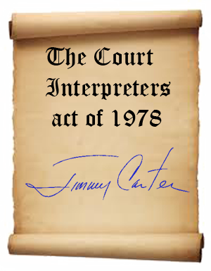
Notes:
the house is very big

Slide 9


What did Juan Alfonzo steal?
Was it a misdemeanor,
or a felony?
CASE NO. 2004-34473-CFAES
STATE OF FLORIDA VS. JUAN RAMON ALFONZO.
Notes:
the house is very big

Slide 10

“ If there is one place under our system of government where all should be in a position to have equal and exact justice done to them, it is a court of law….”
John M. Harlan, 1899
Notes:
the house is very big

Slide 11
WHAT IS THIS SESSION ABOUT?
The difference between being a bilingual person
(...even a highly educated one...)
and being a court interpreter

Slide 12
Integrity of the Proceedings
Relies on Accuracy
Bilingualism is only a starting point
Role is to convey meaning - put person in same situation as an English speaker
No advantage or disadvantage
Not permitted to edit, omit, add context
Interpreter can color view, change impact
Underestimation of skills needed

Slide 13
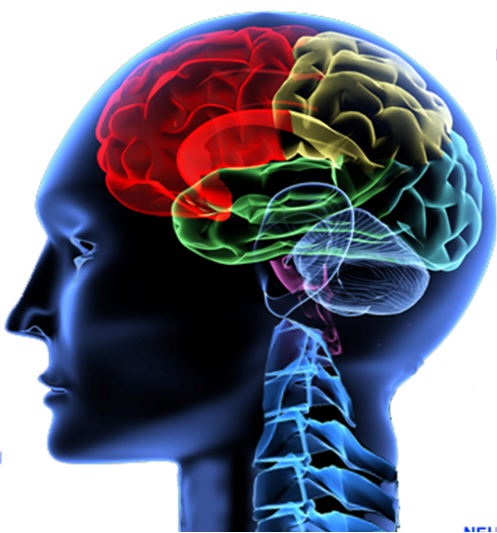
Cognitive Processes Used in Simultaneous
Listening to message
Delivering message while listening - retaining message and monitoring
Deciphering of message
Reconstructing into correct conceptual and language equivalents
Retaining message in short term memory

Slide 14
Word Order In Different Languages
English: The brown house is very big.
Hopi: Brown house very big.
Vietnamese: The house color brown is very big.
Farsi: The house brown very big is.

Slide 15
Noun and Adjective
Position
“The long, hard, rocky road to success.”
____________________
“El camino largo, duro y accidentado hacia el éxito.”

Slide 16
Legalese and Elliptical Language
“Motion to strike priors”
It means:
“A request to ignore previous convictions.”

Slide 17
Legalese and Elliptical Language
“Defendant was violated yesterday”
Incorrect Verbatim Spanish:
“El acusado fué violado ayer”
(Legal) Equivalent in Spanish:
“Al acusado se le imputó de quebrantar su libertad vigilada.”

Slide 18
Passive - Active Voice
“Tocaron a la puerta.”
Incorrect:
“They knocked at the door.”
Correct:
“There was a knock at the door.”

Slide 19
NAVAJO EXAMPLE
The jury will hear what happened on February 3, 1998.
Kaad ei Naakits’aadah dah nidinibiihigii a’dah hootiidigii deeyidool tsiil dii Atsa Biyaash taago yoolkaaleedaa, naahasteetsadahdi neesnaadiin doo bi’aan naahastediin doo bi’aan haashdlahgo yihai aadaa.
February - when the baby eagles are born.

Slide 20
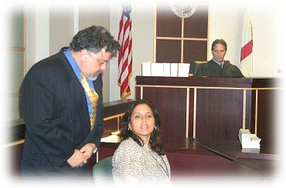
What Is The Interpreter’s Job?
To render everything said in court in the source language
into the target Language

Slide 21
What Is The Interpreter’s Job?
without omissions
accurately, without distortion of meaning
without any changes in style, or “register”
without additions
With as little delay or interference in
the routine pace as possible

Slide 22
SUMMARY FOR INTERPRETERS
Every element must be preserved.
Flavor of speech is important to make judgments about credibility.
Witness should not be interrupted.
Must be able to do simultaneous interpreting.

Slide 23
SUMMARY FOR INTERPRETERS
Should NEVER give legal advice.
Need a comprehensive knowledge of both languages and NEVER misrepresent the level of sophistication of the speaker.
CONSERVATION: Render form and manner including pauses, hedges, self-corrections, and emotions (tone of voice).

Slide 24
To interpret effectively in the courtroom, I must:
Transmit everything that is said accurately and completely
Preserve the tone and level of the original language
NOT paraphrase, summarize, change or omit anything.

Slide 25
Required skills for interpreters
Fluency in both languages
Extensive vocabulary in both languages
Ability to ensure accuracy of meaning
Willingness to follow code of ethics
Ability to function in the Consecutive, Sight Translation, and Simultaneous modes
Above-average memory and multi-tasking competencies.

Slide 26
Judicial Interpreters need to know
The ins and outs of legal professions
What documents pertain to legal proceedings
What kinds of proceedings exist
The types of courts
What parties are involved in legal matters
What levels of offenses exist
General legal jargon

Slide 27

Modes of Interpretation
Consecutive
Simultaneous
Sight Translation

Slide 28
Be prepared:
Accept assignments in accordance with your specialties and skill level
Gather details about the case, your contact, and any other information that might help you prepare
Study up on any pertinent vocabulary
Know the location and how to get to it

Slide 29
Always:
Arrive at least 15 minutes before the assignment
Introduce yourself to court personnel:
  Name and language
  Ask about previous experiences with interpreters
  Explain the function of the interpreter if needed
  Determine the goal of the encounter
Position yourself so you can see and hear everyone

Slide 30
During the assignment:
Always interpret in the first person
Refer to yourself in the third person
Ask for clarification and repetition if necessary
Wait for ruling on an objection before interpreting
Do not reproduce gestures
Do not hold uninterpreted conversations

Slide 31
What if?
The witness responds in English?
The judge asks for the transcription of a tape?
The witness makes a mistake?
The witness is lying?
The judge or the witness start sentences with “Tell him/her that…”?
Someone challenges your interpretation?
You’re told not to interpret something?
You’re distracted by noise?

Slide 32
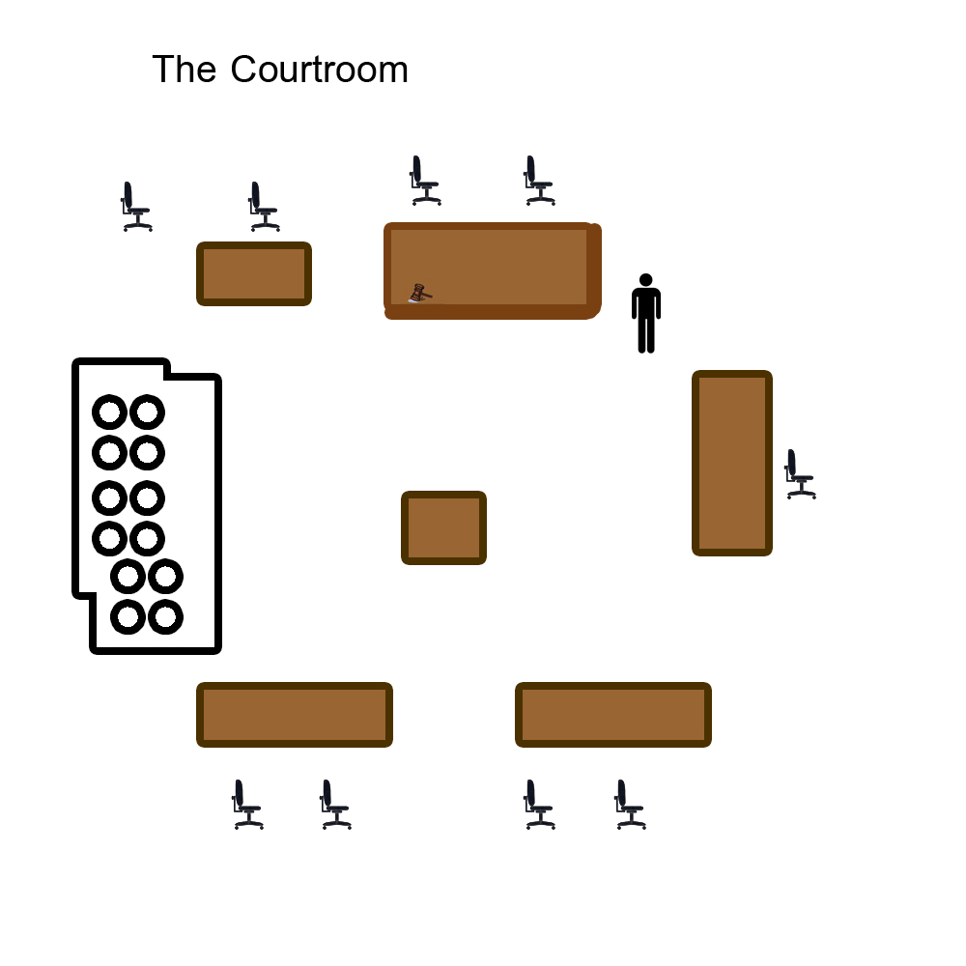
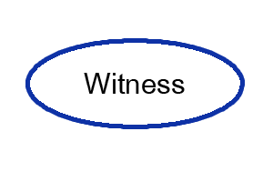
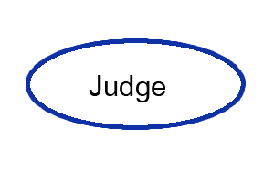
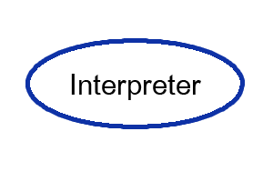
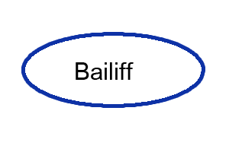
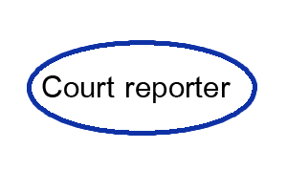

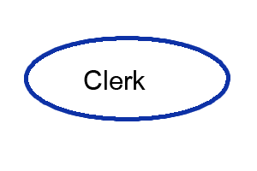
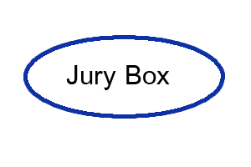
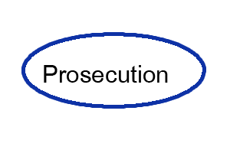
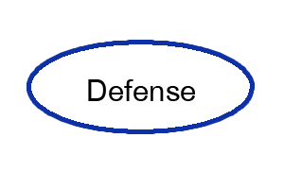

Slide 33
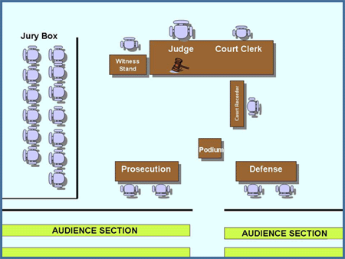

Slide 34
“We don’t have that word in my language”
Arraignment

Slide 35
Interpreter’s Most
Guarded Secret
“You can’t interpret what you don’t understand”

Slide 36
“We don’t have that word in my language”
Arraignment:
Law: To call (an accused person) before a court to answer the charge made against him or her by indictment, information, or complaint.

Slide 37
The Crime
Felony Case
Chronology
of Events
Investigation
Unsolved or not arrested
Defendant
Arrested
Released Without Prosecution
Booking
Released Without Prosecution
Charges Dropped or Dismissed
First Appearance/
Arraignment
A

Slide 38
Information or
Grand Jury
Refuse to indict or
charged
A
Bail or
Detention
First Appearance/
Arraignment
Charges dropped/
dismissed
Pre-trial conf. or
Omnibus
Guilty Plea
Trial
Not Guilty
Sentencing

Slide 39
COMMISSION OF A CRIME
NOTICE TO SUMMONS TO
APPEAR APPEAR
VS.
ARREST
POST BOND NOT POST BOND
INITIAL APPEARANCE
(IN JAIL)
POST BOND NOT POST
BOND
ARRAIGNMENT
OUT OF JAIL
ARRAIGNMENT
IN JAIL

Slide 40
ARRAIGNMENT
(OUT OF JAIL)
ARRAIGNMENT
(IN JAIL)
G/NC
PLEA
NOT G
PLEA
NO SHOW
ARREST
WARRANT
SENTENCE
NOT G
PLEA
G/NC
PLEA
PRE-TRIAL MOTIONS
SUPPRESSION, BOND, ETC.
SENTENCE
PRE-TRIAL
HEARING

Slide 41
NOTICE TO
APPEAR
ARREST
SUMMONS
TO APPEAR
ARREST
POST BOND
NOT POST BOND
INITIAL APPEARANCE
(IN JAIL)
ARRAIGNMENT
(OUT OF JAIL)
POST BOND NOT POST BOND
G/NC
PLEA
NOT G
PLEA
ARREST
ARRAIGNMENT
(IN JAIL)
NO SHOW
WARRANT
NOT G
PLEA
G/NC
PLEA
SENTENCE
PRE-TRIAL MOTIONS
SUPRESSION, BOND, ETC.
SENTENCE
PRE-TRIAL
HEARING

Slide 42
PRE-TRIAL
HEARING
GUILTY/NO CONTEST
PLEA
NOT GUILTY
PLEA
NO SHOW
WARRANT
ARREST
SENTENCE
MOTION TO QUASH/RECALL
PRE-TRIAL
MOTIONS
SUPRESS,
BOND ETC.
DENIED
GRANTED
ARREST
TRIAL

Slide 43
TRIAL
GUILTY/NO
CONTEST PLEA
FOUND
GUILTY
FOUND NOT
GUILTY
NO SHOW
WARRANT
SENTENCE
DISCHARGE
ARREST

Slide 44
PARTS OF A TRIAL
Jury Trial
1. Judge Welcome
  Introduction of parties and participants
  Style of case
  Jury Selection
    Voir dire
    Challenges
      Peremptory
      For cause
Choosing and impaneling the jury

Slide 45
  2. Opening Statements
  Prosecution
  Defense
  3. Prosecution Case
  Presentation of witnesses
    Eye witness
    Expert witness
Witness testimony
  Direct examination
  Cross examination
Exhibits and other evidence
Prosecution rests

Slide 46
  4. Defense Case
  Presentation of witnesses
    Eye witness
    Expert witness
Witness testimony
  Direct examination
  Cross examination
Exhibits and other evidence
Defense rests

Slide 47
5. Closing Arguments
6. Jury Instructions
7. Verdict

Slide 48
Madness:
“People doing the same thing
over and over and expecting
different results”
Albert Einstein

Slide 49
David Kolb’s Learning Cycle
Stages of the Learning Cycle.
Experiencing: Carry out the task without reflection, just intention.
Reflection: Stepping back from task & review what’s been done and experienced.
Conceptualization: Interpreting events noticed. Use theory for framing events.

Slide 50
DO I HAVE WHAT IT TAKES?
KNOWLEDGE
Language
Expertise
ABILITIES
SKILLS
Innate
Talent
Interpreting
Techniques

Slide 51
David Kolb’s Learning Cycle
Stages of the Learning Cycle.
Experiencing: Carry out the task without reflection, just intention.
Reflection: Stepping back from task & review what’s been done and experienced.
Conceptualization: Interpreting events noticed. Use theory for framing events.
Planning: Taking new understanding and deciding actions required to refine task.

Slide 52
Interpreting Style
So you are:
  Intuitive
  Counter-intuitive

Slide 53
Nine Canons
ARTICLE 1: ACCURACY AND COMPLETENESS
ARTICLE 2: REPRESENTATION OF QUALIFICATIONS
ARTICLE 3: IMPARTIALITY AND AVOIDANCE OF CONFLICT OF INTEREST
ARTICLE 4: CONFIDENTIALITY AND RESTRICTION OF PUBLIC COMMENT

Slide 54
Nine Canons
ARTICLE 5: PROFESSIONAL DEMEANOR
ARTICLE 6: SCOPE OF PRACTICE
ARTICLE 7: ASSESSING AND REPORTING IMPEDIMENTS TO PERFORMANCE
ARTICLE 8: DUTY TO REPORT ETHICAL VIOLATIONS
ARTICLE 9: PROFESSIONAL DEVELOPMENT

Slide 55
RESOURCES

Slide 56
Your Orientation Package!

Slide 57
DICTIONARIES
Reputable monolingual for each language
Good bilingual
Reputable Monolingual legal for each language
Good bilingual legal
A good thesaurus for each language

Slide 58
Theory and Practice
Fundamentals of Court Interpretation
ACEBO materials
Subject to Interpretation (Spanish & Language Neutral)
http://www.interpreter-training.com/offers
Materials:
  Court transcripts
  Movies & TV Shows Scripts

Slide 59
Professional Associations
National Association of Judicial Interpreters and Translators www.najit.org
  Proteus Magazine
  Annual Conference
American Translators Association www.atanet.org
  The Chronicle Magazine
  Annual Conference

Slide 60
Educational Institutions
Monterey Institute of International Studies
University of Arizona
  Agnes Haury Institute

Slide 61
The Amazing Internet
Search engines:
Nobody does it better than:
  www.google.com

Slide 62
But most importantly:
GO
TO
COURT!

Slide 63
Agustín Servín de la Mora
www.DELAMORAtraining.com

